Slide 1

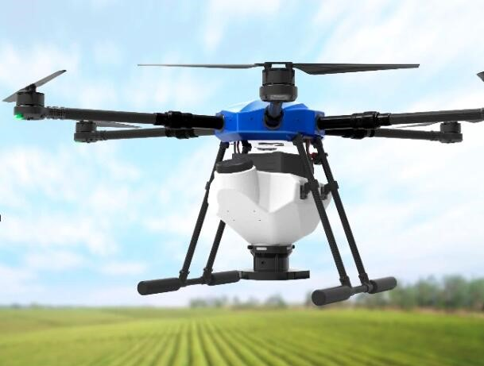
Drone Plant Seeder
DRONE PLANT SEEDER

Slide 2


Agriculture is one among the most promising areas, where drones offer the potential for addressing several major challenges.
In traditional agricultural practices plant seeding consumes lot of time and man power. In order to compensate this issue we replace this with our drone plant seeder
V .Raghu Veera Phani Shankar
A .Venkata Ratnam Naidu
B .Sri Ganesh Sai Pavan
K .Ganga Veerraju

Slide 3

APM ARDUCOPTER is used in drone designing
A simple plant seeding mechanism is introduced to drop seeds manually
It mainly operates in three modes
1.Stable
2.Altitude
3.Position &Hold
Further it can be extended to autonomous mode

Slide 4

Project Requirement , Project Statement
PROJECT LIFE CYCLE
Analysis
Design
Block Diagram , Frame & propellers design
Development
Development of Drone and seed dropping mechanism
Testing
Connecting both the seed and drone mechanism for testing
Implementation
Trying to Implement in farming practices

Slide 5

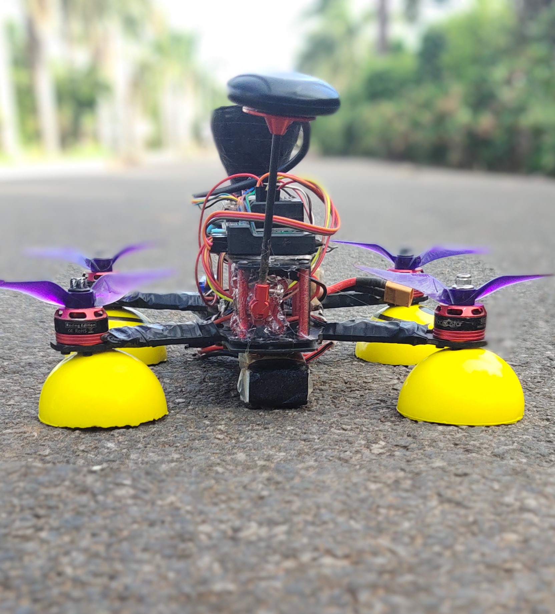
DRONE
PLANT
SEEDER

Slide 6

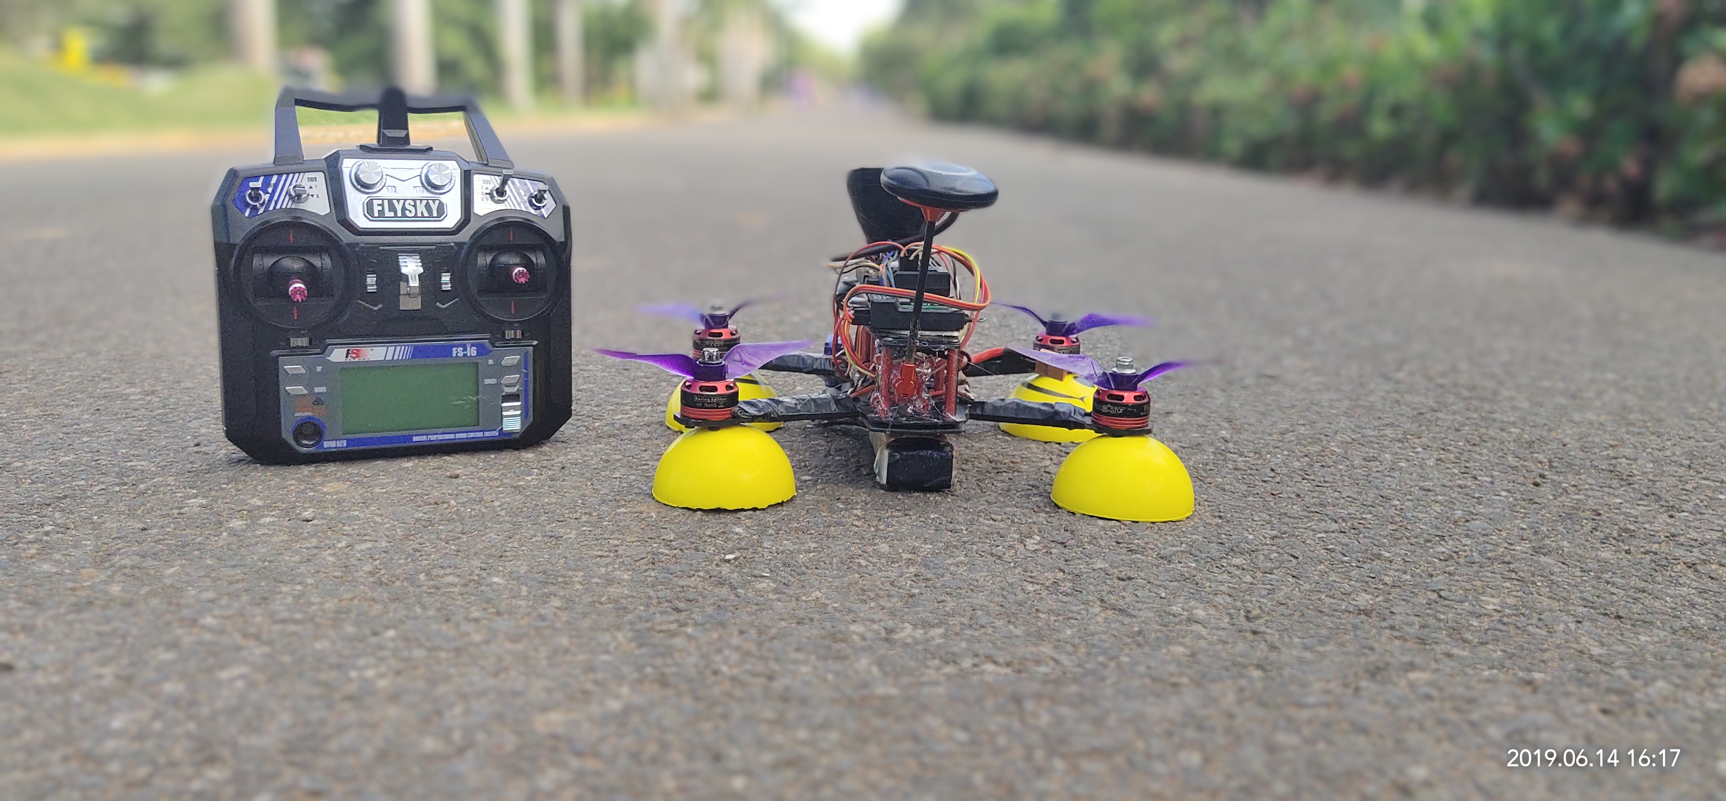
Thanks!
Any questions?
Find me at @Ganga Veerraju &
veerraju2016@gmail.com

